Slide 1

Course : Data Structures
Subject Code : CSEN2001 Program : B. Tech
Year : II
Dept. and Sec : CSE ( )
UNIT : I
Dr Kranthi Kumar Singamaneni
Dept. of C.S.E
G.S.T, GITAM Deemed to be University

Slide 2
Innovation is the mother of necessity
Each innovation in language design was driven by the need to solve a fundamental problem that the preceding languages could not solve.
Progress
versus
Perfection
Perfection focuses on what’s not working, the flaws, the not enoughs.
Progress looks at what is working, the improvements, the discoveries, the aha moments that come from looking at things in a new way.

Slide 3
UNIT - I : Searching and sorting
Introduction to data structures
Array / List based representation and operations
Searching:
Linear search
Binary search
Sorting:
Insertion sort
selection sort
bubble sort
merge sort
quick sort

Slide 4


Slide 5
Why Should you Learn Data Structures and Algorithms?
Most Computer Science students and working professionals tend to skip learning DSA, especially in India, because they find it quite complicated and also because they do not understand the benefits of it fully. What they fail to understand is that DSA has profound uses in various walks of life and not just in making an application more efficient. However, programmers need to realize the importance of DSA as early as possible in their career to be not just better programmer but to contribute significantly to your company by solving their problems.
Reasons to learn DSA: Many people consider DSA as just a mere subject in computer science. This is where they get it wrong. DSA is much more than that. It teaches you a way to be a better programmer and a way to think better. It is a skill that will help you all through your life and is not a skill to learn just to pass a subject. Let us dive deeper into various reasons why one should learn DSA –
1. Role of DSA in Solving Real-World Problems
You will be surprised to know that DSA has quite an important role to play even in solving real-world problems. Real-world problems that take months can be solved in minutes using the knowledge of DSA.
Let us say you want to find a set of people in the same age group within a large collection of data. Assuming this data is sorted, you can solve this issue easily with the binary search algorithm which works on the principle of DSA. The binary search algorithm is considered a logarithmically scalable algorithm, unlike traditional methods that are just linearly scalable. This means, if the number of data points in the database is squared, the time taken to do the same task in the binary search will only be doubled.

Slide 6
Why Should you Learn Data Structures and Algorithms?
1. Another real-world problem that could be solved by DSA is the Rubik cube. Most of you would have used or at least seen this colorful playing object at home. But do you know a simple object like a Rubik cube has confused even the greatest of mathematicians? It is known that a Rubik’s cube has a total of 43,252,003,274,489,856,000 (~43 Quintillion) diffèrent possible positions (Ref: https://www.youtube.com/watch?v=z2-d0x_qxSM). Then imagine the total number of paths to reach all these positions. Thankfully they found the solution to solve it through Djikstra’s algorithm, which is based on the concept of DSA. It helps to solve the problem in linear time, which means you can reach the solved position in the minimum number of states.
2. Role of DSA in Machine Learning
Can you imagine, that a concept as advanced and futuristic as Machine Learning (ML) needs Engineers with knowledge of DSA? Apart from solving real-world problems, these engineers can design amazing products using the combination of their ML and DSA knowledge. The knowledge of DSA is the basic building block of algorithmic thinking, and logical capabilities in any field of computer science, and ML is no exception. An ML engineer spends a considerable part of his time collecting data which can lead to various complex challenges that can be solved easily using the knowledge of DSA. Let us assume you are creating an ML product that has a dataset with the address as one of its columns. Now suppose you want to retrieve a portion of this data, say the street name, then ML cannot work on the string directly. You would need the help of DSA by implementing an algorithm based on a string to retrieve the required data.
3. The core of computer science
Data Structures and Algorithms are often considered to be the root or the foundation of computer science. With advancements in the computer science field, more and more data is getting stored and processed. These huge data can slow down the processing time of the systems. This is where DSA helps by improving the processing power of the systems due to the effective utilization of the stored data. DSA also helps in tasks like data search, which plays an important role in any application. The DSA typically shifts the focus of programming from the syntax to the approach. If you notice, most of the computer science books in any curriculum will have a chapter or a course on DSA. The learners can use the concepts of DSA in any programming language of their choice and also learn how to store and manipulate the data in it to get the desired outcome.

Slide 7
Array, Linked List, Stack, Queues, Searching, Sorting, Tree, Graph…
Do you have questions that why should I study all the above-complicated stuff if it has absolutely no use in real life?? Why do companies ask questions related to data structures and algorithms if it’s not useful in a daily job??
Now I will ask a simple question to you and you need to find the solution for that.
If you need to search your roll number in 20000 pages of PDF document (roll numbers are arranged in increasing order) how would you do that?
If you will try to search it randomly or in a sequential manner it will take too much time. You might get frustrated after some time.
You can try another solution which is given below…
Go to page no. 10000, If your roll no. is not there, but all other roll no. in that page are lesser than your than, Go to page no. 15000. Still if your roll no. is not there. but this time all other roll no. is greater than your Go to page no. 12500
Continue the same process and within 30-40 seconds you will find your roll number. Congratulations… you just have used the Binary Search Algorithm unintentionally..
This was just a simple example, and you might have understood a little bit that why you need to learn data structure and algorithms and its importance in real life. There are plenty of examples you can find in your daily life. So if you think that this skill is only important to crack the interviews of product-based companies then you are totally wrong.
From the above example, we can straightforwardly give two reasons to Learn Data Structure and Algorithms…
If you want to crack the interviews and get into the product-based companies
If you love to solve real-world complex problems.

Slide 8
To Crack the Interviews of the Top Product Based Companies
Do you know that under the hood all your SQL and Linux commands are algorithms and data structures?
You might not realize this, but that’s how the software works.
Data structures and algorithms play a major role in implementing software and in the hiring process as well. A lot of students and professionals have the question of why these companies’ interviews are focused on DSA instead of language/frameworks/tools specific questions?
Let us explain why it happens…
When you ask someone to make a decision for something the good one will be able to tell you “I choose to do X because it’s better than A, B in these ways. I could have gone with C, but I felt this was a better choice because of this“. In our daily life, we always go with that person who can complete the task in a short amount of time with efficiency and using fewer resources. The same things happen with these companies. The problem faced by these companies is much harder and on a much larger scale. Software developers also have to make the right decisions when it comes to solving the problems of these companies.
Knowledge of DS and Algo like Hash Tables, Trees, Graphs, and various algorithms goes a long way in solving these problems efficiently and the interviewers are more interested in seeing how candidates use these tools to solve a problem. Just like a car mechanic needs the right tool to fix a car and make it run properly, a programmer needs the right tool (algorithm and data structure) to make the software run properly. So the interviewer wants to find a candidate who can apply the right set of tools to solve the given problem. . If you know the characteristics of one data structure in contrast to another you will be able to make the right decision in choosing the right data structure to solve a problem.

Slide 9
To Crack the Interviews of the Top Product Based Companies
Engineers working in Google, Microsoft, Facebook, Amazon-like such companies are different than others and paid higher as compared to other companies…but why?
In these companies coding is just the implementation and roughly takes 20-30% of the time allotted to a project. Most of the time goes into designing things with the best and optimum algorithms to save on the company’s resources (servers, computation power, etc). This is the main reason why interviews in these companies are focused on algorithms as they want people who can think out of the box to design algorithms that can save the company thousands of dollars. Youtube, Facebook, Twitter, Instagram, GoogleMaps all these sites have the highest number of users in the world. To handle more users on these sites it requires more optimization to be done and that’s the reason product-based companies only hire candidates who can optimize their software as per user demand.
Example: Suppose you are working in a Facebook company. You come up with an optimal solution of a problem (like sorting a list of users from India) with time complexity of O(nLogn) instead of O(n^2) and assume that n for the problem here for the company in real life scenario is 100 million (very fair assumption considering the number of users registered on Facebook exceeds 1 billion).
nLogn would be 800 million, while n^2 would be 10^7 billion. In cost terms, you can see that the efficiency has been improved more than 10^7 times, which could be a huge saving in terms of server cost and time.
Now you might have got that companies want to hire a smart developer who can make the right decision and save company resources, time, and money. So before you give the solution to use a Hash table instead of List to solve a specific problem think about the big scale and all the case scenarios carefully. It can generate revenue for the company or the company can lose a huge amount of money.
Data structure and algorithms help in understanding the nature of the problem at a deeper level and thereby a better understanding of the world.

Slide 10
To Solve Some Real-World Complex Problems
Have you ever been scolded by your parents when you were unable to find your book or clothes in your messed-up room? Definitely yes…your parents are right when they give the advice to keep everything in the right place so the next time you can get your stuff easily. Here you need to arrange and keep everything (data) in such a structure that whenever you need to search for something you get that easily and as soon as possible. This example gives a clear idea that how important it is to arrange or structure the data in real life.
Now take the example of a library. If you need to find a book on Set Theory from a library, you will go to the maths section first, then the Set Theory section. If these books are not organized in this manner and just distributed randomly then it will be frustrating to find a specific book. So data structures refer to the way we organize information on our computers. Computer scientists process and look for the best way we can organize the data we have, so it can be better processed based on the input provided.
A lot of newbie programmers have this question that where we use all the stuff of data structure and algorithms in our daily life and how it’s useful in solving the real-world complex problem. We need to mention that whether you are interested in getting into the top tech giant companies or not DSA concepts still help a lot in your day-to-day life. Don’t you believe us…Let’s consider some examples…
Facebook (Yes… we are talking about your favorite application). Can you just imagine that your friends on Facebook, friends of friends, mutual friends they all can be represented easily by Graph? Relax….sit for a couple of moments and think again…you can apply a graph to represent friends’ connections on Facebook.
If you need to keep a deck of cards and arrange it properly how would you do that? You will throw it randomly or you will arrange the cards one over another and from a proper deck. You can use Stack here to make a proper arrangement of cards one over another.
If you need to search for a word in the dictionary, what would be your approach? Do you go page by page or do you open some page and if the word is not found you open a page prior to/later to one opened depending upon the order of words to the current page (Binary Search).
The first two were a good example of choosing the right data structure for a real-world problem and the third one is a good example of choosing the right algorithm to solve a specific problem in less amount time.
All the above examples give you a clear understanding that how the organization of data is really important in our day-to-day life. Arranging data in a specific structure is really helpful in saving a lot of time and it becomes easier to manipulate or use them. The same goes for the algorithm…we all want to save our time, energy and resources. We all want to choose the best approach to solve the problems in our daily life. A lot of problems exist in the world that can take hours or days to be solved with the native solution, it also may take years ! can you imagine! watch this: Importance of Data Structure and Algorithms
We are surrounded by a lot of real-world complex problems for which no one has the solution. Observe the problems in-depth and you can help this world by giving the solution that no one has given before.

Slide 11
Introduction to Data Structures
WHAT IS DATA : Data is the collection of different numbers, symbols, and alphabets to represent information.
WHAT IS DATA STRUCTURE : A data structure is a group of data elements that provides the easiest way to store and perform different actions on the data of the computer. A data structure is a particular way of organizing data in a computer so that it can be used effectively. The idea is to reduce the space and time complexities of different tasks.
The choice of a good data structure makes it possible to perform a variety of critical operations effectively. An efficient data structure also uses minimum memory space and execution time to process the structure.
A data structure has also defined an instance of ABSTRACT DATA TYPE (In computer science, an abstract data type is a mathematical model for data types. An abstract data type is defined by its behavior from the point of view of a user, of the data, specifically in terms of possible values, possible operations on data of this type, and the behavior of these operations.)
Type of data structure :
Linear Data Structure
Non-Linear Data Structure
Linear Data Structure: Elements are arranged in one dimension ,also known as linear dimension.
Example: lists, stack, queue, etc.
Non-Linear Data Structure: Elements are arranged in one-many, many-one and many-many dimensions.
Example: tree, graph, table, etc.
Data structures are used in various fields such as:
Operating system
Graphics
Computer Design
Blockchain
Genetics
Image Processing
Simulation etc.

Slide 12
Introduction to Data Structures
Need of Data Structures
As applications are getting complexes and amount of data is increasing day by day, there may arise the following problems:
Processor speed: To handle very large amount of data, high speed processing is required, but as the data is growing day by day to the billions of files per entity, processor may fail to deal with that much amount of data.
Data Search: Consider an inventory size of 106 items in a store, If our application needs to search for a particular item, it needs to traverse 106 items every time, results in slowing down the search process.
Multiple requests: If thousands of users are searching the data simultaneously on a web server, then there are the chances that a very large server can be failed during that process
in order to solve the above problems, data structures are used. Data is organized to form a data structure in such a way that all items are not required to be searched and required data can be searched instantly.
Advantages of Data Structures
Efficiency: Efficiency of a program depends upon the choice of data structures. For example: suppose, we have some data and we need to perform the search for a particular record. In that case, if we organize our data in an array, we will have to search sequentially element by element. hence, using array may not be very efficient here. There are better data structures which can make the search process efficient like ordered array, binary search tree or hash tables.
Reusability: Data structures are reusable, i.e. once we have implemented a particular data structure, we can use it at any other place. Implementation of data structures can be compiled into libraries which can be used by different clients.
Abstraction: Data structure is specified by the ADT which provides a level of abstraction. The client program uses the data structure through interface only, without getting into the implementation details.

Slide 13
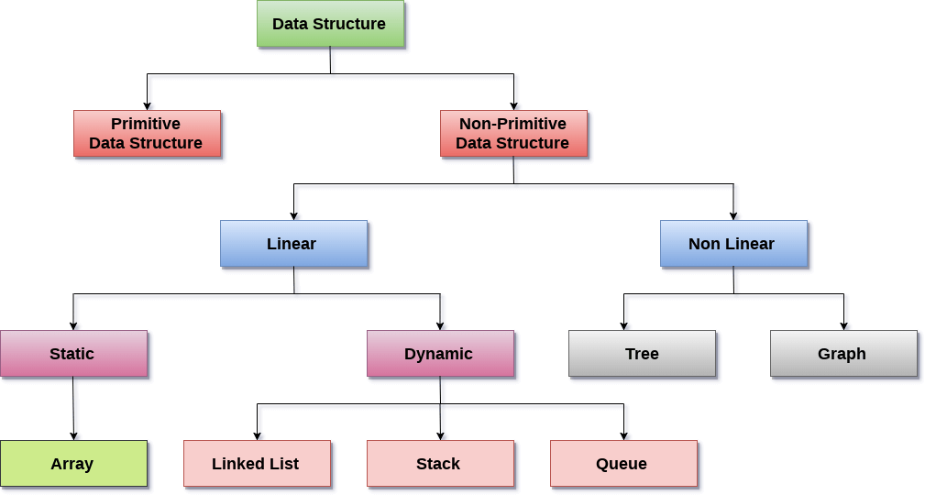
Introduction to Data Structures: Data Structure Classification
Linear Data Structures: A data structure is called linear if all of its elements are arranged in the linear order. In linear data structures, the elements are stored in non-hierarchical way where each element has the successors and predecessors except the first and last element.
Types of Linear Data Structures are given below:
Arrays: An array is a collection of similar type of data items and each data item is called an element of the array. The data type of the element may be any valid data type like char, int, float or double.
The elements of array share the same variable name but each one carries a different index number known as subscript. The array can be one dimensional, two dimensional or multidimensional.
The individual elements of the array age are:
age[0], age[1], age[2], age[3],......... age[98], age[99].

Slide 14
Introduction to Data Structures
Stack: Stack is a linear list in which insertion and deletions are allowed only at one end, called top.
A stack is an abstract data type (ADT), can be implemented in most of the programming languages. It is named as stack because it behaves like a real-world stack, for example: - piles of plates or deck of cards etc.
Queue: Queue is a linear list in which elements can be inserted only at one end called rear and deleted only at the other end called front.
It is an abstract data structure, similar to stack. Queue is opened at both end therefore it follows First-In-First-Out (FIFO) methodology for storing the data items.
Non Linear Data Structures: This data structure does not form a sequence i.e. each item or element is connected with two or more other items in a non-linear arrangement. The data elements are not arranged in sequential structure.
Types of Non Linear Data Structures are given below:
Trees: Trees are multilevel data structures with a hierarchical relationship among its elements known as nodes. The bottommost nodes in the hierarchy are called leaf node while the topmost node is called root node. Each node contains pointers to point adjacent nodes.
Tree data structure is based on the parent-child relationship among the nodes. Each node in the tree can have more than one children except the leaf nodes whereas each node can have utmost one parent except the root node. Trees can be classified into many categories which will be discussed later in this tutorial.
Graphs: Graphs can be defined as the pictorial representation of the set of elements (represented by vertices) connected by the links known as edges. A graph is different from tree in the sense that a graph can have cycle while the tree can not have the one.

Slide 15
Introduction to Data Structures: Operations on data structure
1) Traversing: Every data structure contains the set of data elements. Traversing the data structure means visiting each element of the data structure in order to perform some specific operation like searching or sorting.
Example: If we need to calculate the average of the marks obtained by a student in 6 different subject, we need to traverse the complete array of marks and calculate the total sum, then we will devide that sum by the number of subjects i.e. 6, in order to find the average.
2) Insertion: Insertion can be defined as the process of adding the elements to the data structure at any location.
If the size of data structure is n then we can only insert n-1 data elements into it.
3) Deletion: The process of removing an element from the data structure is called Deletion. We can delete an element from the data structure at any random location.
If we try to delete an element from an empty data structure then underflow occurs.
4) Searching: The process of finding the location of an element within the data structure is called Searching. There are two algorithms to perform searching, Linear Search and Binary Search. We will discuss each one of them later in this tutorial.
5) Sorting: The process of arranging the data structure in a specific order is known as Sorting. There are many algorithms that can be used to perform sorting, for example, insertion sort, selection sort, bubble sort, etc.
6) Merging: When two lists List A and List B of size M and N respectively, of similar type of elements, clubbed or joined to produce the third list, List C of size (M+N), then this process is called merging

Slide 16
Array / List based representation and operations
In this session, we will discuss the array in the data structure. Arrays are defined as the collection of similar types of data items stored at contiguous memory locations. It is one of the simplest data structures where each data element can be randomly accessed by using its index number.
In C programming, they are the derived data types that can store the primitive type of data such as int, char, double, float, etc. For example, if we want to store the marks of a student in 6 subjects, then we don't need to define a different variable for the marks in different subjects. Instead, we can define an array that can store the marks in each subject at the contiguous memory locations.
Properties of array
Each element in an array is of the same data type and carries the same size that is 4 bytes.
Elements in the array are stored at contiguous memory locations from which the first element is stored at the smallest memory location.
Elements of the array can be randomly accessed since we can calculate the address of each element of the array with the given base address and the size of the data element.

Slide 17
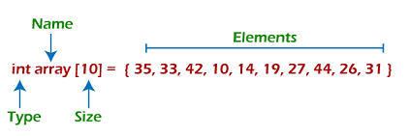
Array / List-based representation and operations: Representation of an array ->
We can represent an array in various ways in different programming languages. As an illustration, let's see the declaration of the array in C language –
As per the above illustration, there are some of the following important points –
Index starts with 0.
The array's length is 10, which means we can store 10 elements.
Each element in the array can be accessed via its index.
Why are arrays required?
Arrays are useful because –
Sorting and searching a value in an array is easier.
Arrays are best to process multiple values quickly and easily.
Arrays are good for storing multiple values in a single variable - In computer programming, most cases require storing a large number of data of a similar type. To store such an amount of data, we need to define a large number of variables. It would be very difficult to remember the names of all the variables while writing the programs. Instead of naming all the variables with a different name, it is better to define an array and store all the elements into it.

Slide 18
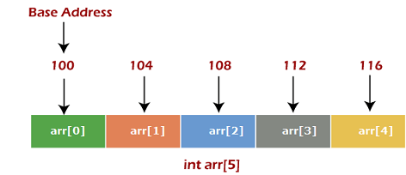
Array / List-based representation and operations: Memory allocation of an array
As stated above, all the data elements of an array are stored at contiguous locations in the main memory. The name of the array represents the base address or the address of the first element in the main memory. Each element of the array is represented by proper indexing.
We can define the indexing of an array in the below ways -\
0 (zero-based indexing): The first element of the array will be arr[0].
1 (one-based indexing): The first element of the array will be arr[1].
n (n - based indexing): The first element of the array can reside at any random index number.
In the above image, we have shown the memory allocation of an array arr of size 5. The array follows a 0-based indexing approach. The base address of the array is 100 bytes. It is the address of arr[0]. Here, the size of the data type used is 4 bytes; therefore, each element will take 4 bytes in the memory.

Slide 19
Array / List-based representation and operations:
How to access an element from the array?
We required the information given below to access any random element from the array –
Base Address of the array.
Size of an element in bytes.
Type of indexing, array follows.
The formula to calculate the address to access an array element –
Byte address of element A[i] = base address + size * ( i - first index)
Here, the size represents the memory taken by the primitive data types. For an instance, int takes 2 bytes, float takes 4 bytes of memory space in C programming.
We can understand it with the help of an example –
Suppose an array, A[-10 ..... +2 ] having Base address (BA) = 999 and size of an element = 2 bytes, find the location of A[-1].
L(A[-1]) = 999 + 2 x [(-1) - (-10)] = 999 + 18 = 1017
Basic operations: Now, let's discuss the basic operations supported in the array –
Traversal - This operation is used to print the elements of the array.
Insertion - It is used to add an element at a particular index.
Deletion - It is used to delete an element from a particular index.
Search - It is used to search an element using the given index or by the value.
Update - It updates an element at a particular index.

Slide 20
Traversal operation: This operation is performed to traverse through the array elements. It prints all array elements one after another. We can understand it with the below program -
void main()
{
int Arr[5] = {18, 30, 15, 70, 12};
int i;
printf("Elements of the array are:\n");
for(i = 0; i<5; i++)
{
printf("Arr[%d] = %d, ", i, Arr[i]);
}
}
Output

Slide 21

Insertion operation: This operation is performed to insert one or more elements into the array. As per the requirements, an element can be added at the beginning, end, or at any index of the array. Now, let's see the implementation of inserting an element into the array.
printf("Array elements after insertion\n");
for (i = 0; i < n; i++)
printf("%d ", arr[i]);
printf("\n");
return 0;
}
int main()
{
int arr[20] = { 18, 30, 15, 70, 12 };
int i, x, pos, n = 5;
printf("Array elements before insertion\n");
for (i = 0; i < n; i++)
printf("%d ", arr[i]);
printf("\n");
x = 50; // element to be inserted
pos = 4;
n++;
for (i = n-1; i >= pos; i--)
arr[i] = arr[i - 1];
arr[pos - 1] = x;
Output

Slide 22

Deletion operation
As the name implies, this operation removes an element from the array and then reorganizes all of the array elements.
printf("\nElements of array after deletion:\n");
for(i = 0; i<n; i++)
{
printf("arr[%d] = %d, ", i, arr[i]);
}
}
void main()
{
int arr[] = {18, 30, 15, 70, 12};
int k = 30, n = 5;
int i, j;
printf("Given array elements are :\n");
for(i = 0; i<n; i++)
{
printf("arr[%d] = %d, ", i, arr[i]);
}
j = k;
while( j < n)
{
arr[j-1] = arr[j];
j = j + 1;
}
n = n -1;
Output

Slide 23

Search operation
This operation is performed to search an element in the array based on the value or index.
void main()
{
int arr[5] = {18, 30, 15, 70, 12}; int item = 70, i, j=0 ;
printf("Given array elements are :\n");
for(i = 0; i<5; i++)
{
printf("arr[%d] = %d, ", i, arr[i]);
}
printf("\nElement to be searched = %d", item);
while( j < 5)
{
if( arr[j] == item )
{
break;
}
j = j + 1;
}
printf("\nElement %d is found at %d position", item, j+1);
}
Output

Slide 24
Search operation
This operation is performed to search an element in the array based on the value or index.
void main()
{
int arr[5] = {18, 30, 15, 70, 12}; int item = 70, i, j=0 ;
printf("Given array elements are :\n");
for(i = 0; i<5; i++)
{
printf("arr[%d] = %d, ", i, arr[i]);
}
printf("\nElement to be searched = %d", item);
while( j < 5)
{
if( arr[j] == item )
{
break;
}
j = j + 1;
}
printf("\nElement %d is found at %d position", item, j+1);
}
Output

Slide 25

Update operation
This operation is performed to update an existing array element located at the given index.
void main()
{
int arr[5] = {18, 30, 15, 70, 12};
int item = 50, i, pos = 3;
printf("Given array elements are :\n");
for(i = 0; i<5; i++)
{
printf("arr[%d] = %d, ", i, arr[i]);
}
arr[pos-1] = item;
printf("\nArray elements after updation :\n");
for(i = 0; i<5; i++)
{
printf("arr[%d] = %d, ", i, arr[i]);
}
}
Output

Slide 26
Array / List-based representation and operations:
The complexity of Array operations:
Time and space complexity of various array operations are described in the following table.
Time Complexity
Space Complexity
In array, space complexity for worst case is O(n).
Advantages of Array
Array provides the single name for the group of variables of the same type. Therefore, it is easy to remember the name of all the elements of an array.
Traversing an array is a very simple process; we just need to increment the base address of the array in order to visit each element one by one.
Any element in the array can be directly accessed by using the index.
Disadvantages of Array
Array is homogenous. It means that the elements with similar data type can be stored in it.
In array, there is static memory allocation that is size of an array cannot be altered.
There will be wastage of memory if we store less number of elements than the declared size.
Conclusion: In this session, we have discussed the special data structure, i.e., array, and the basic operations performed on it. Arrays provide a unique way to structure the stored data such that it can be easily accessed and can be queried to fetch the value using the index.
Operation | Average Case | Worst Case
Access | O(1) | O(1)
Search | O(n) | O(n)
Insertion | O(n) | O(n)
Deletion | O(n) | O(n)

Slide 27
What is Searching in Data Structure?
Searching in data structure refers to the process of finding the required information from a collection of items stored as elements in the computer memory. These sets of items are in different forms, such as an array, linked list, graph, or tree. Another way to define searching in the data structures is by locating the desired element of specific characteristics in a collection of items.
Based on the type of search operation, these algorithms are generally classified into two categories:
Sequential Search:
In this, the list or array is traversed sequentially, and every element is checked. For example: Linear Search.
Interval Search:
These algorithms are specifically designed for searching in sorted data-structures. These type of searching algorithms are much more efficient than Linear Search as they repeatedly target the center of the search structure and divide the search space in half. For Example: Binary Search.

Slide 28
Linear Search Algorithm
Linear search is also called as sequential search algorithm. It is the simplest searching algorithm. In Linear search, we simply traverse the list completely and match each element of the list with the item whose location is to be found. If the match is found, then the location of the item is returned; otherwise, the algorithm returns NULL.
It is widely used to search an element from the unordered list, i.e., the list in which items are not sorted. The worst-case time complexity of linear search is O(n).
The steps used in the implementation of Linear Search are listed as follows -
First, we have to traverse the array elements using a for loop.
In each iteration of for loop, compare the search element with the current array element, and -
→ If the element matches, then return the index of the corresponding array element.
→ If the element does not match, then move to the next element.
If there is no match or the search element is not present in the given array, return -1.

Slide 29

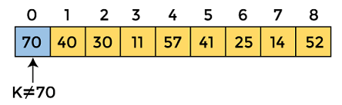
Linear Search Algorithm
Linear_Search(a, n, val) // 'a' is the given array, 'n' is the size of given array, 'val' is the value to search
Step 1: set pos = -1
Step 2: set i = 1
Step 3: repeat step 4 while i <= n
Step 4: if a[i] == val
set pos = i
print pos
go to step 6
[end of if]
set ii = i + 1
[end of loop]
Step 5: if pos = -1
print "value is not present in the array "
[end of if]
Step 6: exit
Working of Linear search: Now, let's see the working of the linear search Algorithm.
To understand the working of linear search algorithm, let's take an unsorted array. It will be easy to understand the working of linear search with an example.
Let the elements of array are –
Let the element to be searched is K = 41
Now, start from the first element and compare K with each element of the array.
The value of K, i.e., 41, is not matched with the first element of the array. So, move to the next element. And follow the same process until the respective element is found.

Slide 30
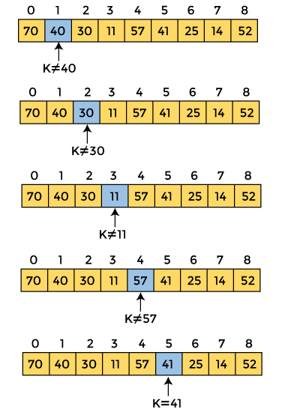
Linear Search Algorithm
Linear Search complexity: Now, let's see the time complexity of linear search in the best case, average case, and worst case. We will also see the space complexity of linear search.
Time Complexity
Case | Time Complexity
Best Case | O(1)
Average Case | O(n)
Worst Case | O(n)
Best Case Complexity - In Linear search, best case occurs when the element we are finding is at the first position of the array. The best-case time complexity of linear search is O(1).
Average Case Complexity - The average case time complexity of linear search is O(n).
Worst Case Complexity - In Linear search, the worst case occurs when the element we are looking is present at the end of the array. The worst-case in linear search could be when the target element is not present in the given array, and we have to traverse the entire array. The worst-case time complexity of linear search is O(n).
The time complexity of linear search is O(n) because every element in the array is compared only once.
Now, the element to be searched is found. So, algorithm will return the index of the element matched.

Slide 31
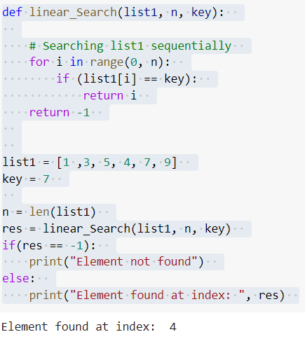
Linear Search Algorithm
2. Space Complexity
int result = Linear_search(arr, n, key);
if(result == -1)
printf("Element is not present in array")
Else
printf("Element is present at index %d", result);
return 0;
}
Space Complexity | O(1)
Implementation of Linear Search: Now, let's see the programs of linear search in different programming languages.
Program: Write a program to implement linear search in C language.
int Linear_search(int arr[], int n, int key)
{
int i;
for (i = 0; i<n; i++)
if (arr[i] == key) //key is the lement to be searched
return i;
return -1; //when the element is not present inside the array
}
int main(void)
{
int arr[] = { 5, 3, 6, 2, 20, 7};
int key = 20;
int n = sizeof(arr) / sizeof(arr[0]);

Slide 32
Course : Data Structures
Subject Code : CSEN2001 Program : B. Tech
Year : II
Dept. and Sec : CSE ( )
UNIT : I
Dr Kranthi Kumar Singamaneni
Dept. of C.S.E
G.S.T, GITAM Deemed to be University

Slide 33
Innovation is the mother of necessity
Each innovation in language design was driven by the need to solve a fundamental problem that the preceding languages could not solve.
Progress
versus
Perfection
Perfection focuses on what’s not working, the flaws, the not enoughs.
Progress looks at what is working, the improvements, the discoveries, the aha moments that come from looking at things in a new way.

Slide 34
UNIT - I : Searching and sorting
Introduction to data structures
Array / List based representation and operations
Searching:
Linear search
Binary search
Sorting:
Insertion sort
selection sort
bubble sort
merge sort
quick sort

Slide 35
What is Searching in Data Structure?
Searching in data structure refers to the process of finding the required information from a collection of items stored as elements in the computer memory. These sets of items are in different forms, such as an array, linked list, graph, or tree. Another way to define searching in the data structures is by locating the desired element of specific characteristics in a collection of items.
Based on the type of search operation, these algorithms are generally classified into two categories:
Sequential Search:
In this, the list or array is traversed sequentially, and every element is checked. For example: Linear Search.
Interval Search:
These algorithms are specifically designed for searching in sorted data-structures. These type of searching algorithms are much more efficient than Linear Search as they repeatedly target the center of the search structure and divide the search space in half. For Example: Binary Search.

Slide 36
Linear Search Algorithm
Linear search is also called as sequential search algorithm. It is the simplest searching algorithm. In Linear search, we simply traverse the list completely and match each element of the list with the item whose location is to be found. If the match is found, then the location of the item is returned; otherwise, the algorithm returns NULL.
It is widely used to search an element from the unordered list, i.e., the list in which items are not sorted. The worst-case time complexity of linear search is O(n).
The steps used in the implementation of Linear Search are listed as follows -
First, we have to traverse the array elements using a for loop.
In each iteration of for loop, compare the search element with the current array element, and -
→ If the element matches, then return the index of the corresponding array element.
→ If the element does not match, then move to the next element.
If there is no match or the search element is not present in the given array, return -1.

Slide 37
Linear Search Algorithm
Linear_Search(a, n, val) // 'a' is the given array, 'n' is the size of given array, 'val' is the value to search
Step 1: set pos = -1
Step 2: set i = 1
Step 3: repeat step 4 while i <= n
Step 4: if a[i] == val
set pos = i
print pos
go to step 6
[end of if]
set ii = i + 1
[end of loop]
Step 5: if pos = -1
print "value is not present in the array "
[end of if]
Step 6: exit
Working of Linear search: Now, let's see the working of the linear search Algorithm.
To understand the working of linear search algorithm, let's take an unsorted array. It will be easy to understand the working of linear search with an example.
Let the elements of array are –
Let the element to be searched is K = 41
Now, start from the first element and compare K with each element of the array.
The value of K, i.e., 41, is not matched with the first element of the array. So, move to the next element. And follow the same process until the respective element is found.

Slide 38
Linear Search Algorithm
Linear Search complexity: Now, let's see the time complexity of linear search in the best case, average case, and worst case. We will also see the space complexity of linear search.
Time Complexity
Case | Time Complexity
Best Case | O(1)
Average Case | O(n)
Worst Case | O(n)
Best Case Complexity - In Linear search, best case occurs when the element we are finding is at the first position of the array. The best-case time complexity of linear search is O(1).
Average Case Complexity - The average case time complexity of linear search is O(n).
Worst Case Complexity - In Linear search, the worst case occurs when the element we are looking is present at the end of the array. The worst-case in linear search could be when the target element is not present in the given array, and we have to traverse the entire array. The worst-case time complexity of linear search is O(n).
The time complexity of linear search is O(n) because every element in the array is compared only once.
Now, the element to be searched is found. So, algorithm will return the index of the element matched.

Slide 39
Linear Search Algorithm
2. Space Complexity
int result = Linear_search(arr, n, key);
if(result == -1)
printf("Element is not present in array")
Else
printf("Element is present at index %d", result);
return 0;
}
Space Complexity | O(1)
Implementation of Linear Search: Now, let's see the programs of linear search in different programming languages.
Program: Write a program to implement linear search in C language.
int Linear_search(int arr[], int n, int key)
{
int i;
for (i = 0; i<n; i++)
if (arr[i] == key) //key is the lement to be searched
return i;
return -1; //when the element is not present inside the array
}
int main(void)
{
int arr[] = { 5, 3, 6, 2, 20, 7};
int key = 20;
int n = sizeof(arr) / sizeof(arr[0]);

Slide 40
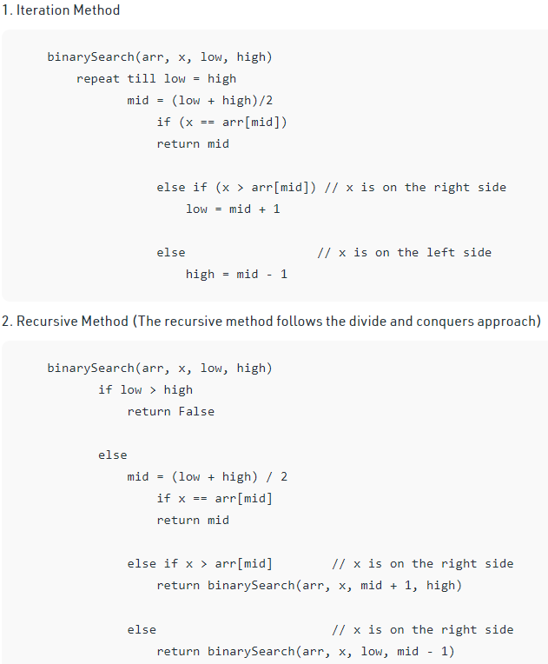
Binary Search is a searching algorithm used in a sorted array by repeatedly dividing the search interval in half. The idea of binary search is to use the information that the array is sorted and reduce the time complexity to O(Log n).
Binary Search Algorithm: The basic steps to performing Binary Search are:
Begin with the mid element of the whole array as a search key.
If the value of the search key is equal to the item then return an index of the search key.
Or if the value of the search key is less than the item in the middle of the interval, narrow the interval to the lower half.
Otherwise, narrow it to the upper half.
Repeatedly check from the second point until the value is found or the interval is empty.
Binary Search Algorithm can be implemented in the following two ways
Iterative Method 2.Recursive Method

Slide 41
// Recursive Binary Search
int binarySearch(int arr[], int l, int r, int x)
{
if (r >= l)
{
int mid = l + (r - l) / 2;
// If the element is present at the middle itself
if (arr[mid] == x) return mid;
// If element is smaller than mid, then it must present in left subarray
if (arr[mid] > x) return binarySearch(arr, l, mid - 1, x);
// Else the element can only be present in right subarray
return binarySearch(arr, mid + 1, r, x);
}
// We reach here when element is not present in array
return -1;
}
int main(void)
{
int arr[] = { 2, 3, 4, 10, 40 }; int x = 10; int n = sizeof(arr) / sizeof(arr[0]);
int result = binarySearch(arr, 0, n - 1, x);
(result == -1)
? printf("Element is not present in array")
: printf("Element is present at index %d", result); return 0;
}
// Iterative Binary Search in C
int binarySearch(int array[], int x, int low, int high)
{
// Repeat until the pointers low and high meet each other
while (low <= high)
{
int mid = low + (high - low) / 2;
if (array[mid] == x) return mid;
if (array[mid] < x) low = mid + 1;
else high = mid - 1;
}
return -1;
}
int main(void)
{
int array[] = {3, 4, 5, 6, 7, 8, 9}; int x = 4;
int n = sizeof(array) / sizeof(array[0]);
int result = binarySearch(array, x, 0, n - 1);
if (result == -1) printf("Not found");
else printf("Element is found at index %d", result);
return 0;
}

Slide 42
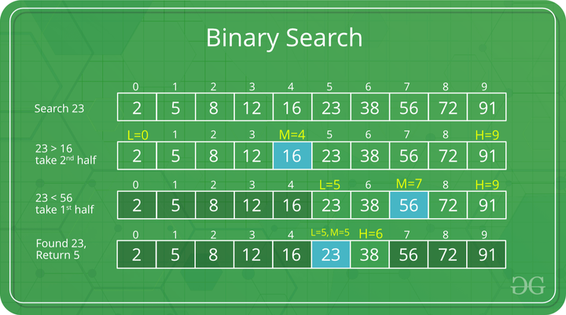
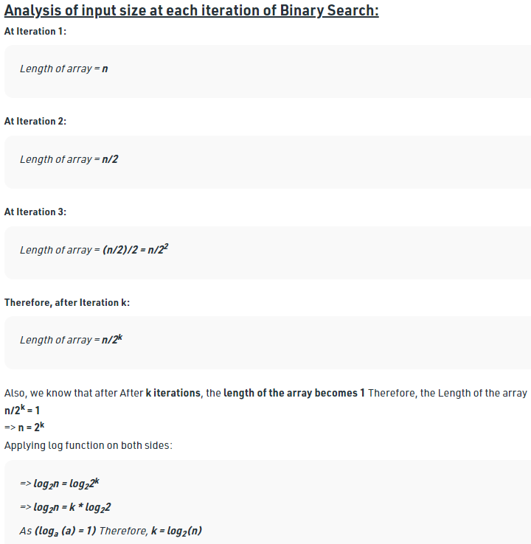
Illustration of Binary Search Algorithm:
Complexity Analysis of Binary Search
Step-by-step Binary Search Algorithm: We basically ignore half of the elements just after one comparison.
Compare x with the middle element.
If x matches with the middle element, we return the mid index.
Else If x is greater than the mid element, then x can only lie in the right half subarray after the mid element. So we recur for the right half.
Else (x is smaller) recur for the left half.

Slide 43
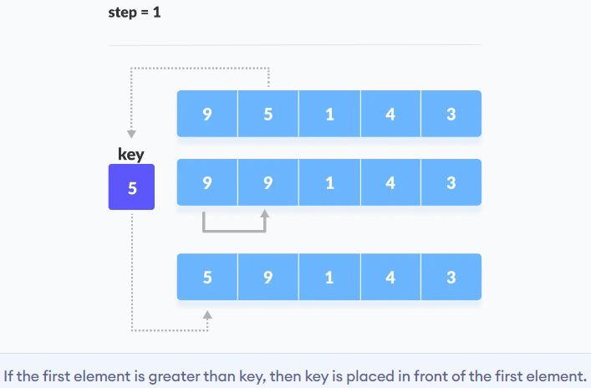
Sorting Techniques: Insertion Sort
How Does Insertion Sort Work?
Suppose we need to sort the following array.
Insertion sort is a sorting algorithm that places an unsorted element at its suitable place in each iteration.
Insertion sort works similarly to we sort cards in our hands in a card game.
We assume that the first card is already sorted then, we select an unsorted card. If the unsorted card is greater than the card in hand, it is placed on the right otherwise, to the left. In the same way, other unsorted cards are taken and put in their right place.
A similar approach is used by insertion sort.
The first element in the array is assumed to be sorted. Take the second element and store it separately in key
Compare the key with the first element. If the first element is greater than the key, then the key is placed in front of the first element.
Characteristics of Insertion Sort:
This algorithm is one of the simplest algorithms with simple implementation
Basically, Insertion sort is efficient for small data values
Insertion sort is adaptive in nature, i.e. it is appropriate for data sets that are already partially sorted.

Slide 44
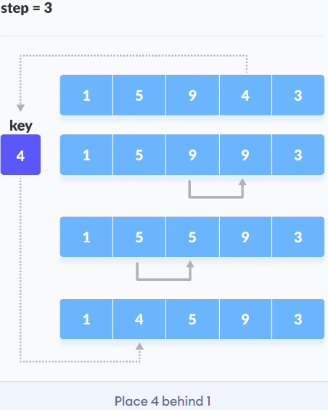
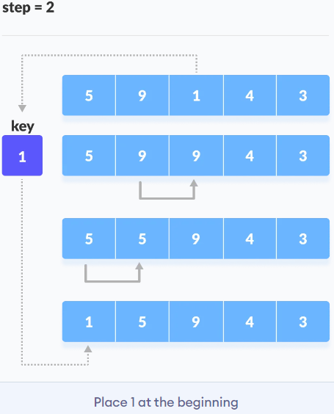
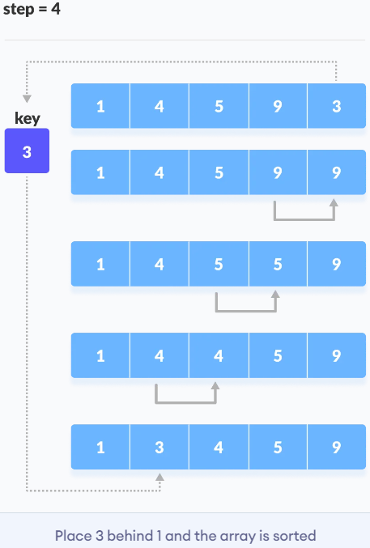
Sorting Techniques: Insertion Sort (cont.)
3. Similarly, place every unsorted element in its correct position.
2. Now, the first two elements are sorted. Take the third element and compare it with the elements on the left of it. Placed it just behind the element smaller than it. If there is no element smaller than it, then place it at the beginning of the array.

Slide 45
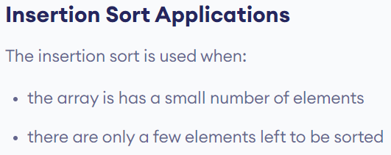
Sorting Techniques: Insertion Sort (cont.)
// Insertion sort in C
void printArray(int array[], int size) // Function to print an array
{
for (int i = 0; i < size; i++)
{
printf("%d ", array[i]);
}
printf("\n");
}
void insertionSort(int array[], int size)
{
for (int step = 1; step < size; step++)
{
int key = array[step]; int j = step - 1;
// Compare key with each element on the left of it until an element smaller than it is found.
// For descending order, change key<array[j] to key>array[j].
while (key < array[j] && j >= 0)
{
array[j + 1] = array[j]; --j;
}
array[j + 1] = key;
}
}
// Driver code
int main()
{
int data[] = {9, 5, 1, 4, 3};
int size = sizeof(data) / sizeof(data[0]);
insertionSort(data, size);
printf("Sorted array in ascending order:\n");
printArray(data, size);
}

Slide 46
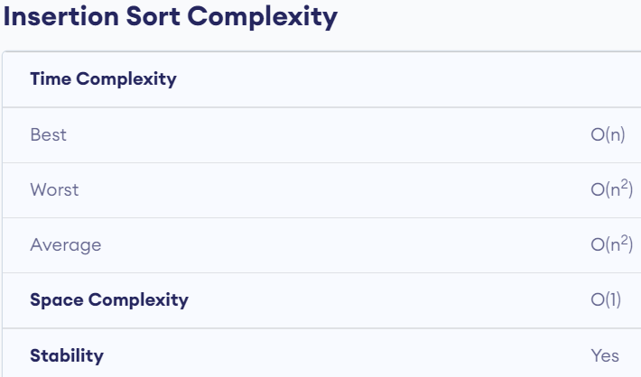
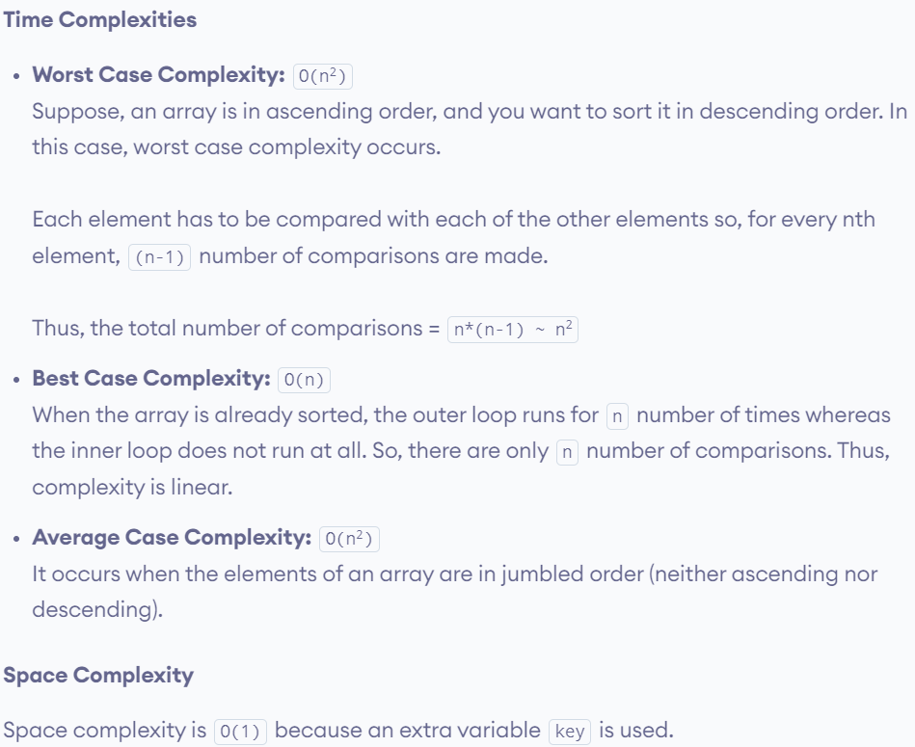
Sorting Techniques: Insertion Sort (cont.)
# Insertion sort in Python
def insertionSort(array):
for step in range(1, len(array)):
key = array[step]
j = step - 1
# Compare key with each element on the left of it until an element smaller than it is found
# For descending order, change key<array[j] to key>array[j].
while j >= 0 and key < array[j]:
array[j + 1] = array[j]
j = j - 1
# Place key at after the element just smaller than it.
array[j + 1] = key
data = [9, 5, 1, 4, 3]
insertionSort(data)
print('Sorted Array in Ascending Order:')
print(data)

Slide 48
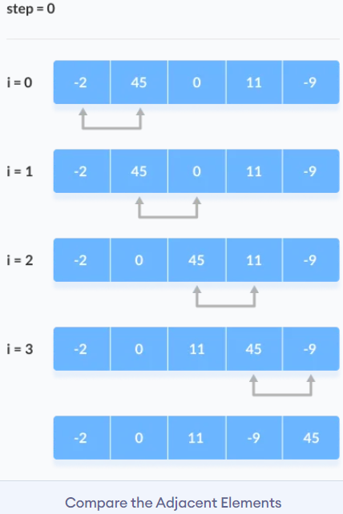
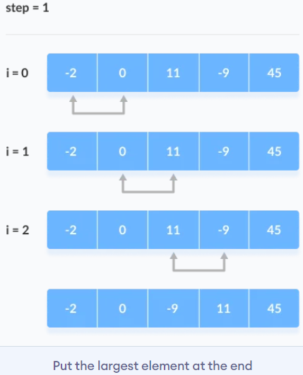
Sorting Techniques: Bubble Sort
1. First Iteration (Compare and Swap)
Starting from the first index, compare the first and the second elements.
If the first element is greater than the second element, they are swapped.
Now, compare the second and the third elements. Swap them if they are not in order.
The above process goes on until the last element.
Bubble Sort is the simplest sorting algorithm that works by repeatedly swapping the adjacent elements if they are in the wrong order. This algorithm is not suitable for large data sets as its average and worst-case time complexity is quite high.
2. Remaining Iteration: The same process goes on for the remaining iterations. After each iteration, the largest element among the unsorted elements is placed at the end.
Working of Bubble Sort: Suppose we are trying to sort the elements in ascending order.

Slide 49
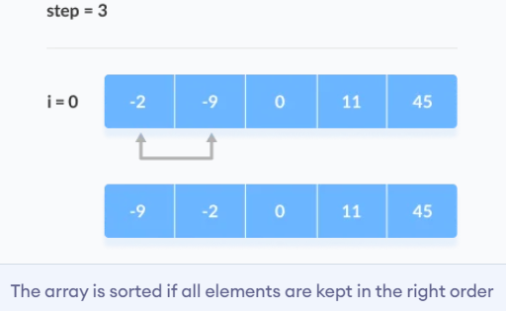
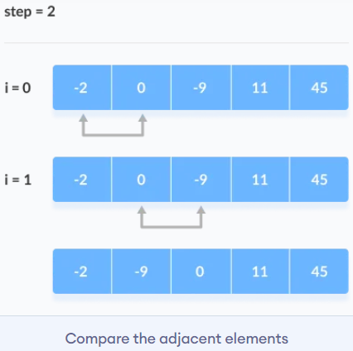
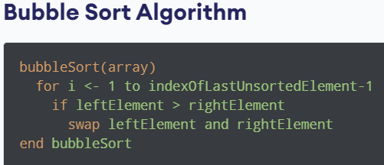
Sorting Techniques: Bubble Sort
The array is sorted when all the unsorted elements are placed at their correct positions.
In each iteration, the comparison takes place up to the last unsorted element.

Slide 50
// print array
void printArray(int array[], int size)
{
for (int i = 0; i < size; ++i)
{
printf("%d ", array[i]);
}
printf("\n");
}
int main()
{
int data[] = {-2, 45, 0, 11, -9};
// find the array's length
int size = sizeof(data) / sizeof(data[0]);
bubbleSort(data, size);
printf("Sorted Array in Ascending Order:\n");
printArray(data, size);
}
// Bubble sort in C
void bubbleSort(int array[ ], int size) // perform the bubble sort
{
for (int step = 0; step < size - 1; ++step) // loop to access each array element
{
for (int i = 0; i < size - step - 1; ++i) // loop to compare array elements
{
//compare two adjacent elements change > to < to sort in descending order
if (array[i] > array[i + 1])
{
// swapping occurs if elements are not in the intended order
int temp = array[i];
array[i] = array[i + 1];
array[i + 1] = temp;
}
}
}
}

Slide 51
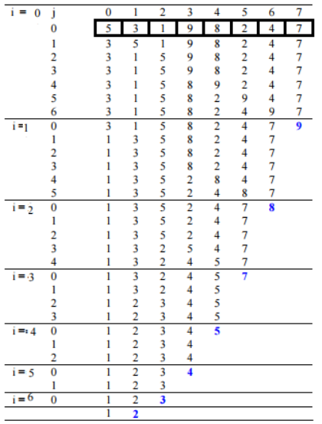
Another Illustration:
# Bubble sort in Python
def bubbleSort(array):
for i in range(len(array)): # loop to access each array element
for j in range(0, len(array) - i - 1): # loop to compare array elements
# compare two adjacent elements
# change > to < to sort in descending order
if array[j] > array[j + 1]:
# swapping elements if elements
# are not in the intended order
temp = array[j]
array[j] = array[j+1]
array[j+1] = temp
data = [-2, 45, 0, 11, -9]
bubbleSort(data)
print('Sorted Array in Ascending Order:')
print(data)

Slide 52
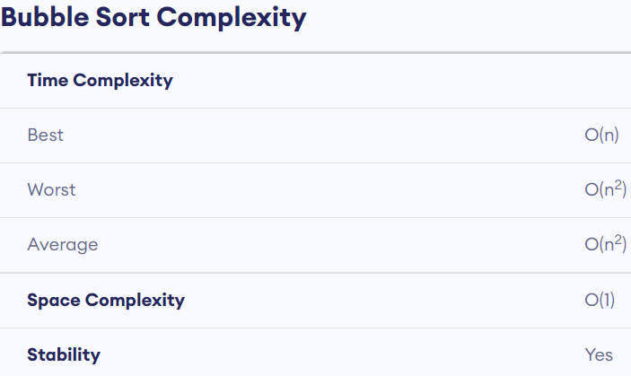
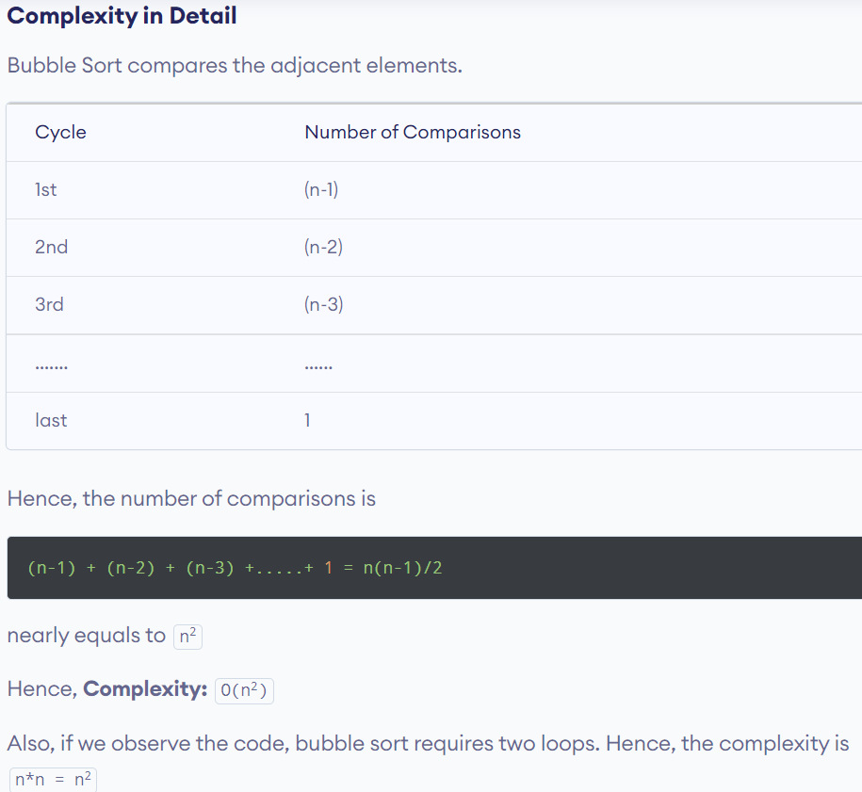
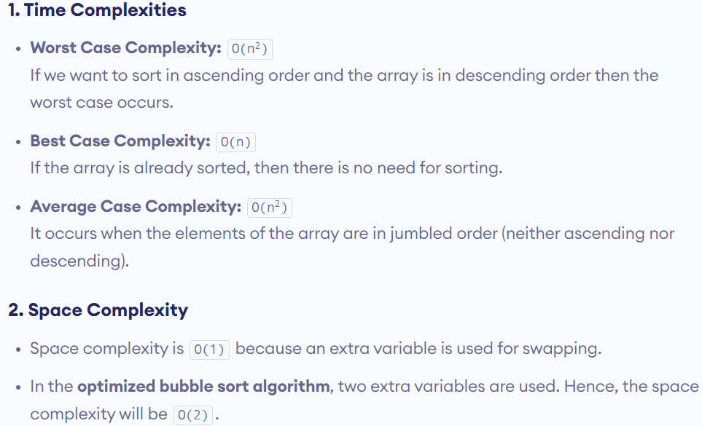

Slide 53
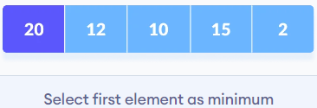
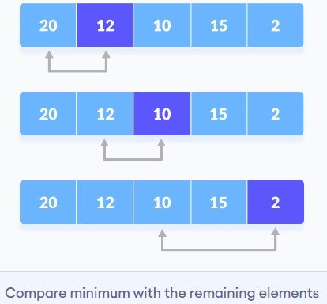
Sorting Techniques: Selection Sort
In selection sort, the smallest value among the unsorted elements of the array is selected in every pass and inserted to its appropriate position into the array. It is also the simplest algorithm. It is an in-place comparison sorting algorithm.
In this algorithm, the array is divided into two parts, first is sorted part, and another one is the unsorted part. Initially, the sorted part of the array is empty, and unsorted part is the given array. Sorted part is placed at the left, while the unsorted part is placed at the right.
In selection sort, the first smallest element is selected from the unsorted array and placed at the first position. After that second smallest element is selected and placed in the second position. The process continues until the array is entirely sorted.
Selection sort is generally used when –
A small array is to be sorted
Swapping cost doesn't matter
It is compulsory to check all elements
Set the first element as minimum
Compare minimum with the second element. If the second element is smaller than the minimum, assign the second element as minimum
Compare the minimum with the third element. Again, if the third element is smaller, then assign that minimum to the third element otherwise do nothing. The process goes on until the last element.

Slide 54
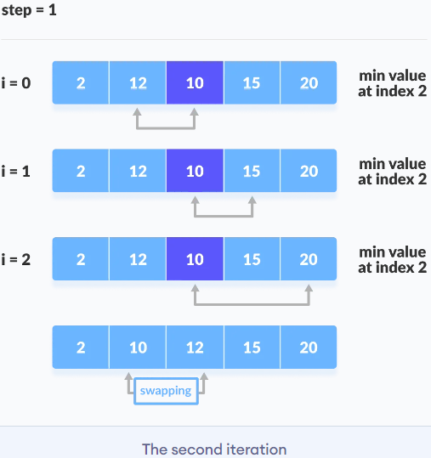
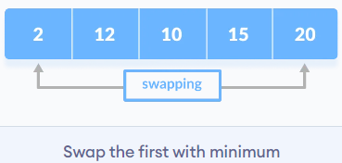
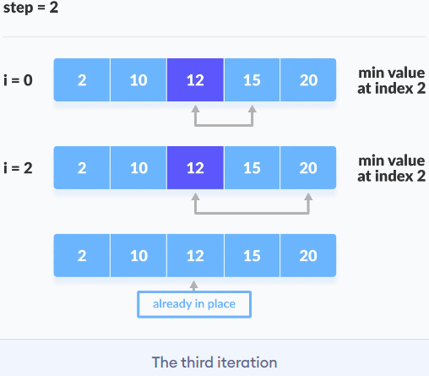
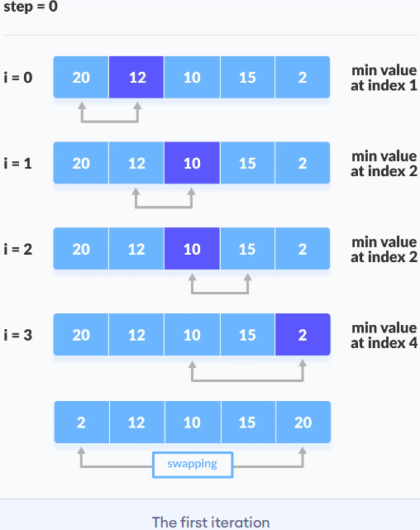
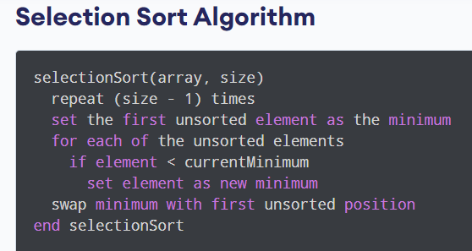
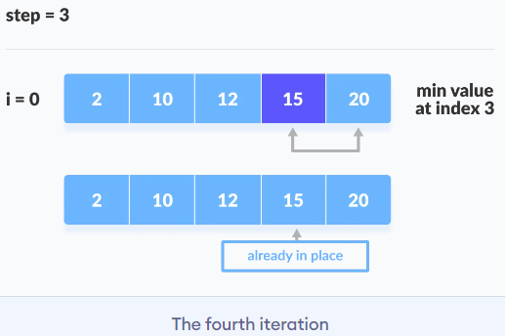
Sorting Techniques: Selection Sort (cont.): Working of Selection Sort
3. After each iteration, the minimum is placed in the front
of the unsorted list.
4. For each iteration, indexing starts from the first unsorted element. Step 1 to 3 are repeated until all the elements are placed at their correct positions.

Slide 55
Sorting Techniques: Selection Sort (cont.): Code
void swap(int *a, int *b)
{
int temp = *a;
*a = *b;
*b = temp;
}
void selectionSort(int array[], int size)
{
for (int step = 0; step < size - 1; step++)
{
int min_idx = step;
for (int i = step + 1; i < size; i++)
{
if (array[i] < array[min_idx])
min_idx = i;
}
swap(&array[min_idx], &array[step]);
}
}
void printArray(int array[], int size)
{
for (int i = 0; i < size; ++i)
{
printf("%d ", array[i]);
}
printf("\n");
}
int main()
{
int data[] = {20, 12, 10, 15, 2};
int size = sizeof(data) / sizeof(data[0]);
selectionSort(data, size);
printf("Sorted array in Acsending Order:\n");
printArray(data, size);
}
# Selection sort in Python
def selectionSort(array, size):
for step in range(size):
min_idx = step
for i in range(step + 1, size):
# to sort in descending order, change > to < in this line
# select the minimum element in each loop
if array[i] < array[min_idx]:
min_idx = i
# put min at the correct position
(array[step], array[min_idx]) = (array[min_idx], array[step])
data = [-2, 45, 0, 11, -9]
size = len(data)
selectionSort(data, size)
print('Sorted Array in Ascending Order:')
print(data)

Slide 56
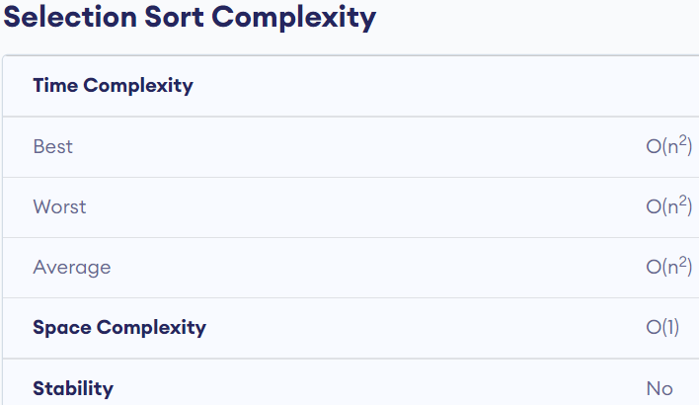
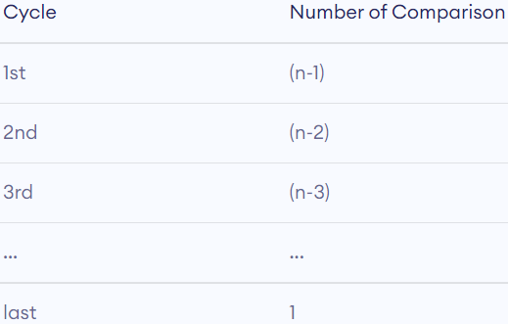
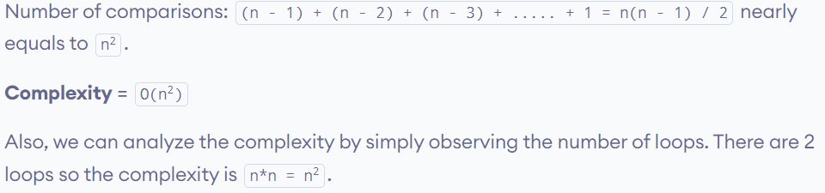
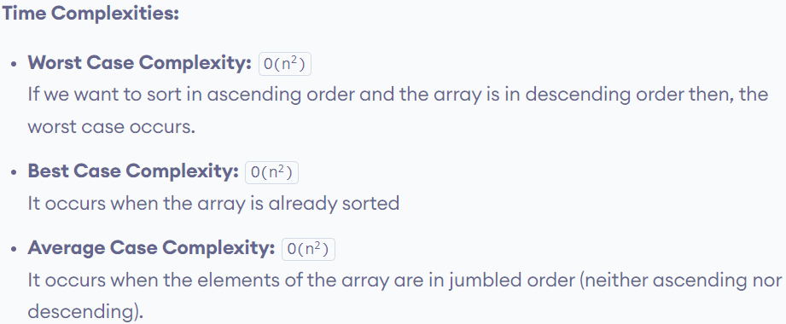
Sorting Techniques: Selection Sort (cont.)
The time complexity of the selection sort is the same in all cases. At every step, you have to find the minimum element and put it in the right place. The minimum element is not known until the end of the array is not reached.
Space Complexity:
Space complexity is O(1) because an extra variable temp is used
Selection Sort Applications
The selection sort is used when
a small list is to be sorted
cost of swapping does not matter
checking of all the elements is compulsory

Slide 57
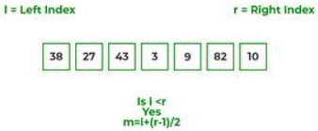

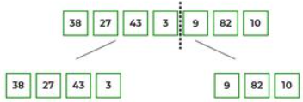
Sorting Techniques: Merge Sort
At first, check if the left index of an array is less than the right index, if yes then calculate its midpoint
Merge Sort is one of the most popular sorting algorithms that is based on the principle of the Divide and Conquer strategy.
Here, a problem is divided into multiple sub-problems. Each sub-problem is solved individually. Finally, sub-problems are combined to form the final solution.
Now, as we already know that merge sort first divides the whole array iteratively into equal halves, unless the atomic values are achieved.
Here, we see that an array of 7 items is divided into two arrays of size 4 and 3 respectively.
Merge Sort Working Process:
Think of it as a recursive algorithm continuously splits the array in half until it cannot be further divided. This means that if the array becomes empty or has only one element left, the dividing will stop, i.e. it is the base case to stop the recursion.
If the array has multiple elements, split the array into halves and recursively invoke the merge sort on each of the halves. Finally, when both halves are sorted, the merge operation is applied. Merge operation is the process of taking two smaller sorted arrays and combining them to eventually make a larger one.
Illustration: To know the functioning of merge sort, lets consider an array arr[] = {38, 27, 43, 3, 9, 82, 10}
Now, again find that is left index is less than the right index for both arrays, if found yes, then again calculate mid points for both the arrays.

Slide 58
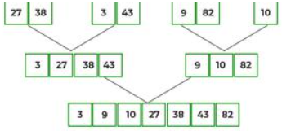
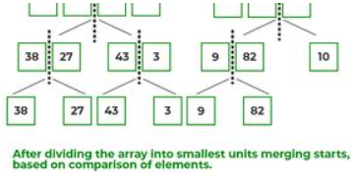
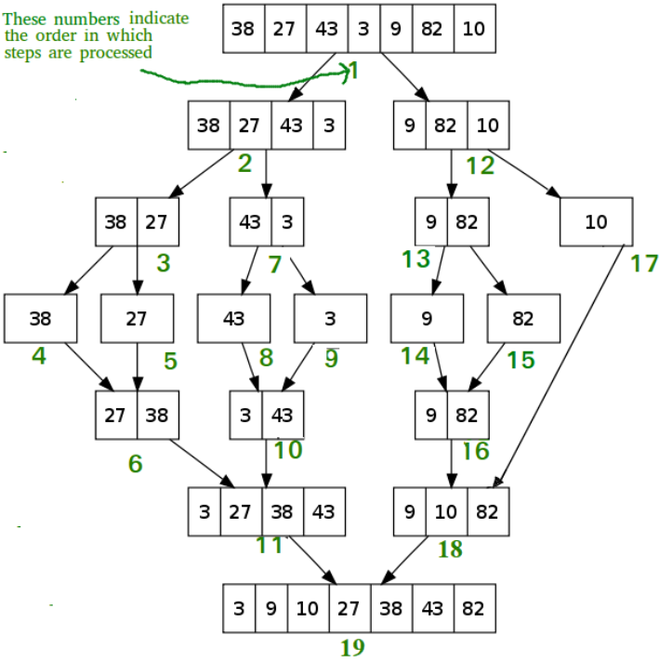
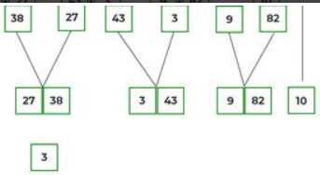
Sorting Techniques: Merge Sort (cont.)
After the final merging, the list looks like this:
Now, further divide these two arrays into further halves, until the atomic units of the array is reached and further division is not possible.
The following diagram shows the complete merge sort process for an example array {38, 27, 43, 3, 9, 82, 10}.
If we take a closer look at the diagram, we can see that the array is recursively divided into two halves till the size becomes 1. Once the size becomes 1, the merge processes come into action and start merging arrays back till the complete array is merged.
After dividing the array into smallest units, start merging the elements again based on comparison of size of elements
Firstly, compare the element for each list and then combine them into another list in a sorted manner.

Slide 59
/* C program for Merge Sort */
/* Merges two subarrays of arr[].
First subarray is arr[l..m].
Second subarray is arr[m+1..r]*/
void merge(int arr[], int l, int m, int r)
{
int i, j, k; int n1 = m - l + 1; int n2 = r - m;
int L[n1], R[n2]; /* create temp arrays */
/* Copy data to temp arrays L[] and R[] */
for (i = 0; i < n1; i++) L[i] = arr[l + i];
for (j = 0; j < n2; j++) R[j] = arr[m + 1 + j];
/* Merge the temp arrays back into arr[l..r]*/
i = 0; // Initial index of first subarray
j = 0; // Initial index of second subarray
k = l; // Initial index of merged subarray
while (i < n1 && j < n2)
{
if (L[i] <= R[j])
{
arr[k] = L[i]; i++;
}
else
{
arr[k] = R[j]; j++;
}
k++;
}
/* Copy the remaining elements of L[], if there are any */
while (i < n1)
{
arr[k] = L[i]; i++; k++;
}
/* Copy the remaining elements of R[], if there are any */
while (j < n2)
{
arr[k] = R[j]; j++; k++;
}
}
/* l is for left index and r is right index of the sub-array of arr to be sorted */
void mergeSort(int arr[], int l, int r)
{
if (l < r)
{
// Same as (l+r)/2, but avoids overflow for large l and h
int m = l + (r - l) / 2;
// Sort first and second halves
mergeSort(arr, l, m);
mergeSort(arr, m + 1, r);
merge(arr, l, m, r);
}
}
/* UTILITY FUNCTIONS */
/* Function to print an array */
void printArray(int A[], int size)
{
int i;
for (i = 0; i < size; i++)
printf("%d ", A[i]);
printf("\n");
}
/* Driver code */
int main()
{
int arr[] = { 12, 11, 13, 5, 6, 7 };
int arr_size = sizeof(arr) / sizeof(arr[0]);
printf("Given array is \n");
printArray(arr, arr_size);
mergeSort(arr, 0, arr_size - 1);
printf("\nSorted array is \n");
printArray(arr, arr_size);
return 0;
}

Slide 60
# Python program for implementation of MergeSort
def mergeSort(arr):
if len(arr) > 1:
mid = len(arr)//2
L = arr[:mid]
R = arr[mid:]
# Sorting the first half
mergeSort(L)
# Sorting the second half
mergeSort(R)
i = j = k = 0
# Copy data to temp arrays L[] and R[]
while i < len(L) and j < len(R):
if L[i] < R[j]:
arr[k] = L[i]
i += 1
else:
arr[k] = R[j]
j += 1
k += 1
# Checking if any element was left
while i < len(L):
arr[k] = L[i]
i += 1
k += 1
while j < len(R):
arr[k] = R[j]
j += 1
k += 1
)
# Code to print the list
def printList(arr):
for i in range(len(arr)):
print(arr[i], end=" ")
print()
# Driver Code
if __name__ == '__main__':
arr = [12, 11, 13, 5, 6, 7]
print("Given array is", end="\n")
printList(arr)
mergeSort(arr)
print("Sorted array is: ", end="\n")
printList(arr

Slide 61
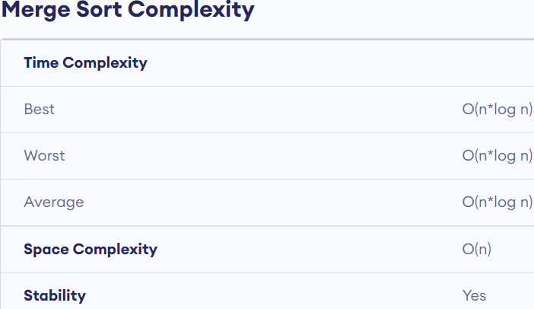
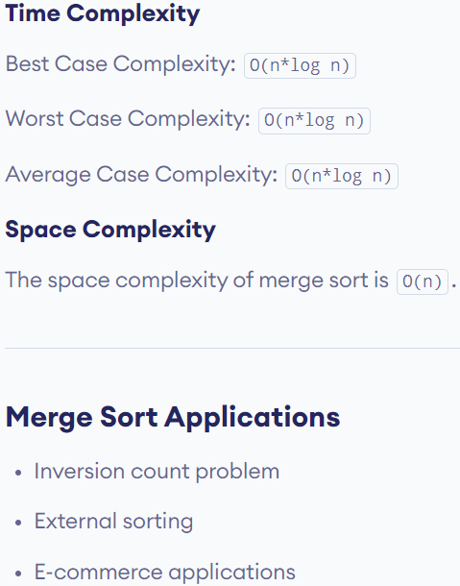
Time Complexity: O(N log(N)), Sorting arrays on different machines. Merge Sort is a recursive algorithm and time complexity can be expressed as following recurrence relation.
T(n) = 2T(n/2) + θ(n)
The above recurrence can be solved either using the Recurrence Tree method or the Master method. It falls in case II of the Master Method and the solution of the recurrence is θ(Nlog(N)).
The time complexity of Merge Sort isθ(Nlog(N)) in all 3 cases (worst, average, and best) as merge sort always divides the array into two halves and takes linear time to merge two halves.
Auxiliary Space: O(n), In merge sort all elements are copied into an auxiliary array. So N auxiliary space is required for merge sort.

Slide 62
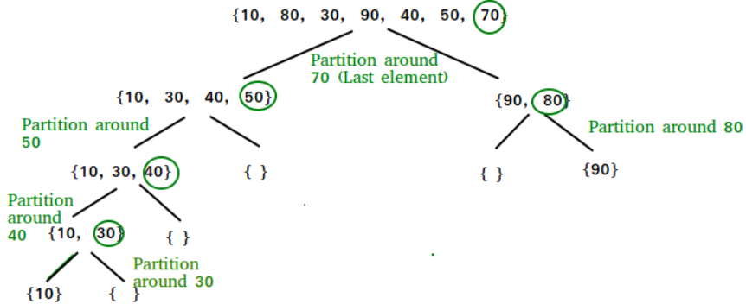
Sorting Techniques: Quick Sort
Like merge sort, quick sort is also based on the divide and conquer approach.
It picks an element as a pivot and partitions the given array around the picked pivot.
There are many different versions of the quick sort that pick pivot in different ways.
Always pick the first element as a pivot.
Always pick the last element as a pivot (implemented below)
Pick a random element as a pivot.
Pick median as the pivot.
The key process in quick sort is a partition(). The target of partitions is, given an array and an element x of an array as the pivot, put x at its correct position in a sorted array and put all smaller elements (smaller than x) before x, and put all greater elements (greater than x) after x. All this should be done in linear time.
Partition Algorithm:
There can be many ways to do partition, following pseudo-code adopts the method given in the CLRS book. The logic is simple, we start from the leftmost element and keep track of the index of smaller (or equal to) elements as i. While traversing, if we find a smaller element, we swap the current element with arr[i]. Otherwise, we ignore the current element.

Slide 63
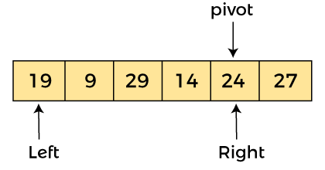

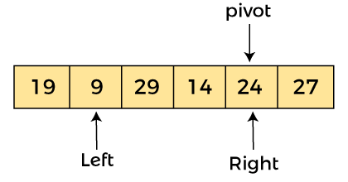
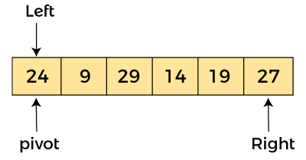
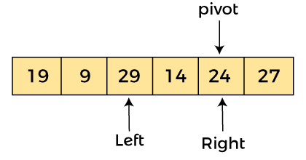


Sorting Techniques: Working of Quick Sort (cont.)
Let the elements of an array are
In the given array, we consider the leftmost element as the pivot.
So, in this case, a[left] = 24, a[right] = 27 and a[pivot] = 24.
Since, the pivot is at the left, so algorithm starts from the right and moves toward left.
-
Now, a[left] = 19, a[right] = 24, and a[pivot] = 24. Since, the pivot is at the right, so algorithm starts from the left and moves to the right
As a[pivot] > a[left], so algorithm moves one position to right as
Now, a[left] = 9, a[right] = 24, and a[pivot] = 24. As a[pivot] > a[left], so algorithm moves one position to right as -
Now, a[pivot] < a[right], so algorithm moves forward one position towards left, i.e. -
Now, a[left] = 29, a[right] = 24, and a[pivot] = 24. As a[pivot] < a[left], so, swap a[pivot] and a[left], now pivot is at left, i.e. -
Now, a[left] = 24, a[right] = 19, and a[pivot] = 24.
Because, a[pivot] > a[right], so, algorithm will swap a[pivot] with a[right], and pivot moves to right, as -

Slide 64





Sorting Techniques: Working of Quick Sort (cont.)
Element 24, which is the pivot element is placed at its exact position.
Elements that are right side of element 24 are greater than it, and the elements that are left side of element 24 are smaller than it.
Since, pivot is at left, so algorithm starts from right, and move to left. Now, a[left] = 24, a[right] = 29, and a[pivot] = 24. As a[pivot] < a[right], so algorithm moves one position to left, as -
Now, a[pivot] = 24, a[left] = 24, and a[right] = 14. As a[pivot] > a[right], so, swap a[pivot] and a[right], now pivot is at right, i.e. -
Now, in a similar manner, quick sort algorithm is separately applied to the left and right sub-arrays. After sorting gets done, the array will be -
Now, a[pivot] = 24, a[left] = 14, and a[right] = 24. Pivot is at right, so the algorithm starts from left and move to right.
Case | Time Complexity
Best Case | O(n*logn)
Average Case | O(n*logn)
Worst Case | O(n²)
Now, a[pivot] = 24, a[left] = 24, and a[right] = 24. So, pivot, left and right are pointing the same element. It represents the termination of procedure.

Slide 65
// Quick sort in C
void swap(int *a, int *b) // function to swap elements
{
int t = *a; *a = *b; *b = t;
}
// function to find the partition position
int partition(int array[], int low, int high)
{
int pivot = array[high]; // select the rightmost element as pivot
int i = (low - 1); // pointer for greater element
// traverse each element of the array and compare them with the pivot
for (int j = low; j < high; j++)
{
if (array[j] <= pivot)
{
// if element smaller than pivot is found
// swap it with the greater element pointed by i
i++;
// swap element at i with element at j
swap(&array[i], &array[j]);
}
}
// swap the pivot element with the greater element at i
swap(&array[i + 1], &array[high]);
return (i + 1); // return the partition point
}
void quickSort(int array[], int low, int high)
{
if (low < high)
{
// find the pivot element such that elements smaller than pivot are on
// left of pivot elements greater than pivot are on right of pivot
int pi = partition(array, low, high);
quickSort(array, low, pi - 1); // recursive call on the left of pivot
quickSort(array, pi + 1, high); // recursive call on the right of pivot
}
}
void printArray(int array[], int size) // function to print array elements
{
for (int i = 0; i < size; ++i)
{
printf("%d ", array[i]);
}
printf("\n");
}
int main()
{
int data[] = {8, 7, 2, 1, 0, 9, 6}; int n = sizeof(data) / sizeof(data[0]);
printf("Unsorted Array\n"); printArray(data, n);
quickSort(data, 0, n - 1); // perform quicksort on data
printf("Sorted array in ascending order: \n");
printArray(data, n);
}

Slide 66
# Quick sort in Python
# function to find the partition position
def partition(array, low, high):
# choose the rightmost element as pivot
pivot = array[high]
# pointer for greater element
i = low - 1
# traverse through all elements
# compare each element with pivot
for j in range(low, high):
if array[j] <= pivot:
# if element smaller than pivot is found
# swap it with the greater element pointed by i
i = i + 1
# swapping element at i with element at j
(array[i], array[j]) = (array[j], array[i])
# swap the pivot element with the greater element specified by i
(array[i + 1], array[high]) = (array[high], array[i + 1])
# return the position from where partition is done
return i + 1
# function to perform quicksort
def quickSort(array, low, high):
if low < high:
# find pivot element such that
# element smaller than pivot are on the left
# element greater than pivot are on the right
pi = partition(array, low, high)
# recursive call on the left of pivot
quickSort(array, low, pi - 1)
# recursive call on the right of pivot
quickSort(array, pi + 1, high)
data = [8, 7, 2, 1, 0, 9, 6]
print("Unsorted Array")
print(data)
size = len(data)
quickSort(data, 0, size - 1)
print('Sorted Array in Ascending Order:')
print(data)
Quicksort Applications
The quicksort algorithm is used when
the programming language is good for recursion
time complexity matters
space complexity matters

